Slide 1
AI's Impact on Education
An Overview

Slide 2
Slide 1: AI Integration in Education
- AI has been increasingly integrated into educational settings, impacting both teaching and learning experiences.
- It offers new opportunities for personalized learning, efficient assessment, and interactive engagements.
- This slide will explore the benefits of AI integration in education.

Slide 3
Slide 2: Enhanced Personalization
- AI enables personalized learning experiences by adapting to individual student needs.
- Personalized recommendations help students access tailored resources and content.
- Adaptive learning tools, powered by AI, adjust to each student's learning pace.

Slide 4
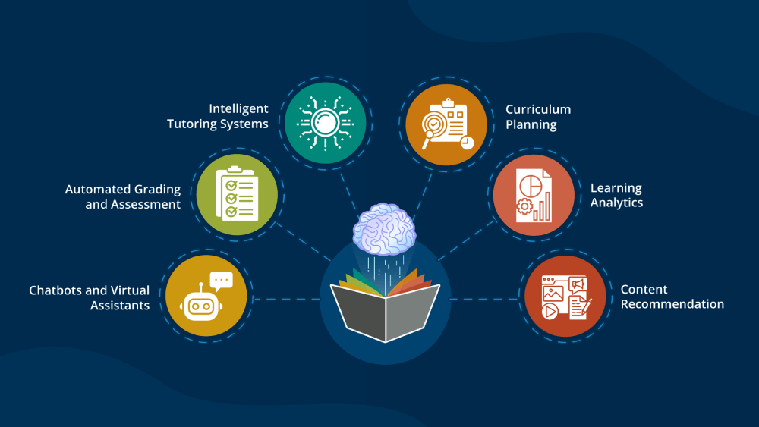
Slide 3: Visual Representation
AI in Education

Slide 5
Slide 4: Efficient Assessment
- AI-powered assessment tools provide quick and accurate analysis of student performance.
- These tools offer real-time feedback, helping students identify areas for improvement.
- They also reduce the time teachers spend on grading, allowing more focus on instruction.

Slide 6
Slide 5: Interactive Engagements
- AI enables interactive and immersive learning experiences.
- Virtual reality and chatbot-based learning, powered by AI, enhance student engagement.
- These technologies make learning more accessible and interactive.

Slide 7
Slide 6: Future Implications
- AI's impact on education is expected to grow significantly in the future.
- It can help address educational challenges and achieve inclusive learning goals.
- AI-powered educational tools must be developed responsibly, ensuring ethical considerations.

Slide 8
Conclusion

